Slide 1
AMAZON INDIA DASHBOARD
By Agatha Z Swett

Slide 2
1
Overall Sales & Profit Performance
TOTAL SALES
₹155,789,893.89
TOTAL UNITS SOLD
24,926
Avg. Monthly Sales
₹160,112.94
TOTAL PROFIT
₹33,167,008.49
Average Order Value
₹15,578.99
Avg. Monthly Profit
₹34,087.37
TOTAL ORDERS
10000
Profit margin %
₹33,167,008.49

Slide 3
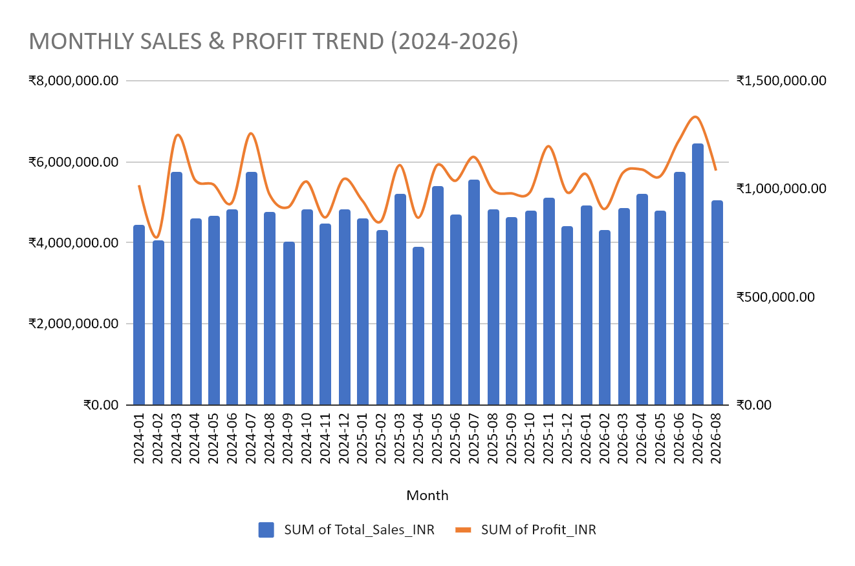
Overall Sales & Profit Performance

Slide 4
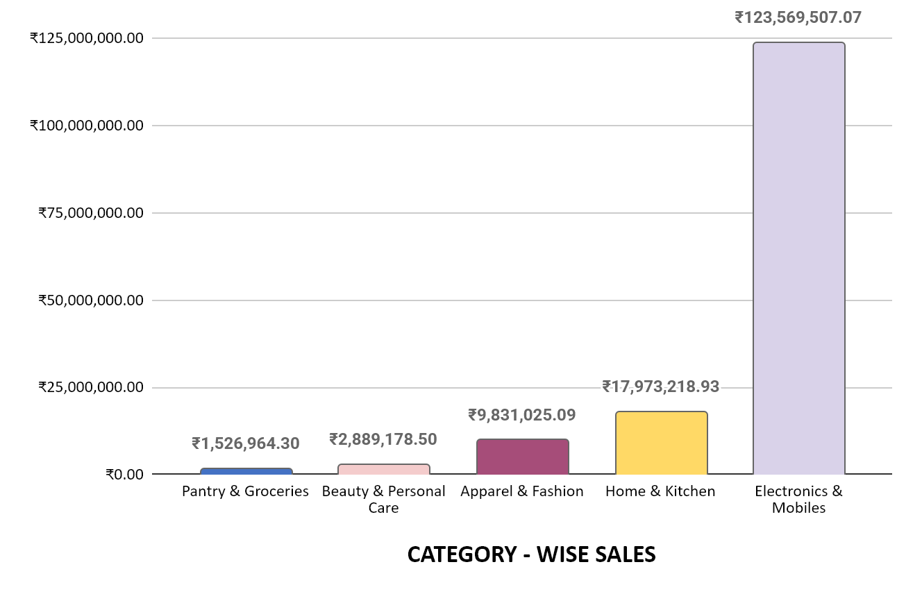
Category & Product Performance
Category-wise Sales
Electronics & Mobiles
₹123,569,507.07

Slide 5
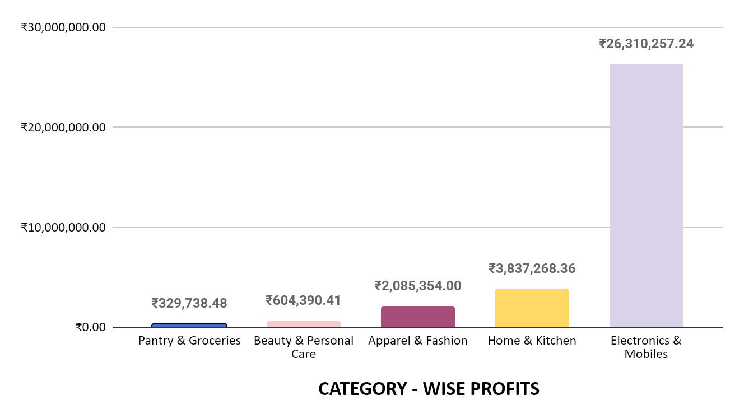
Category & Product Performance
Category-wise Profit
Electronics & Mobiles
₹26,310,257.24

Slide 6
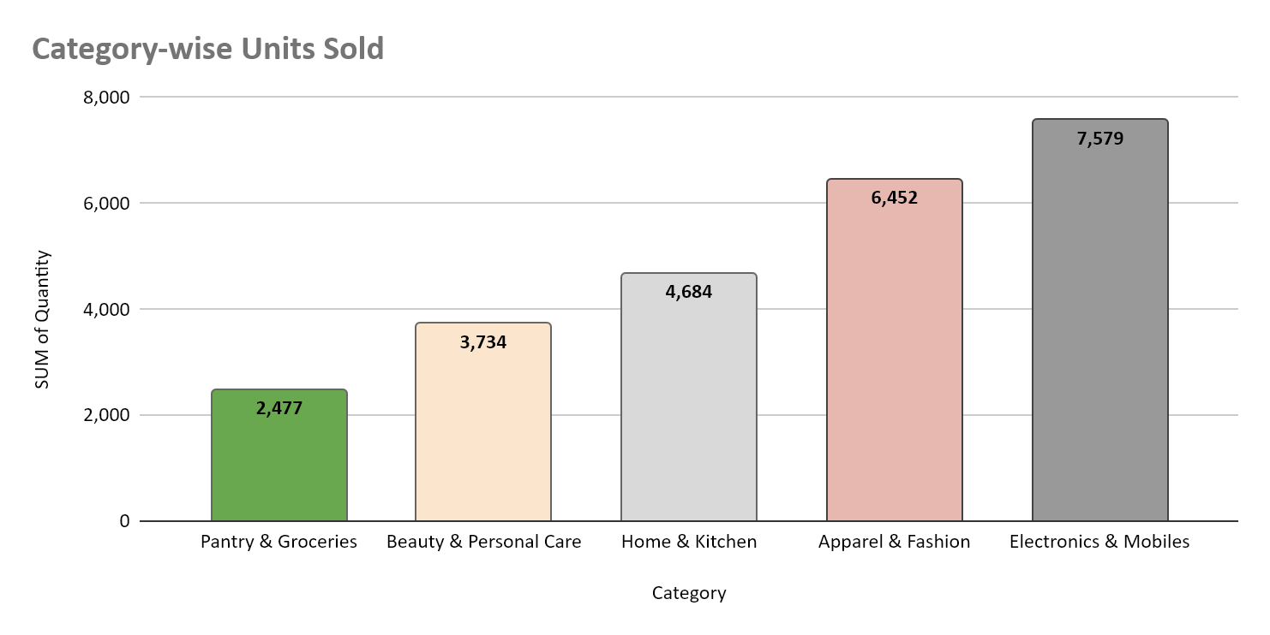
Category & Product Performance

Slide 7
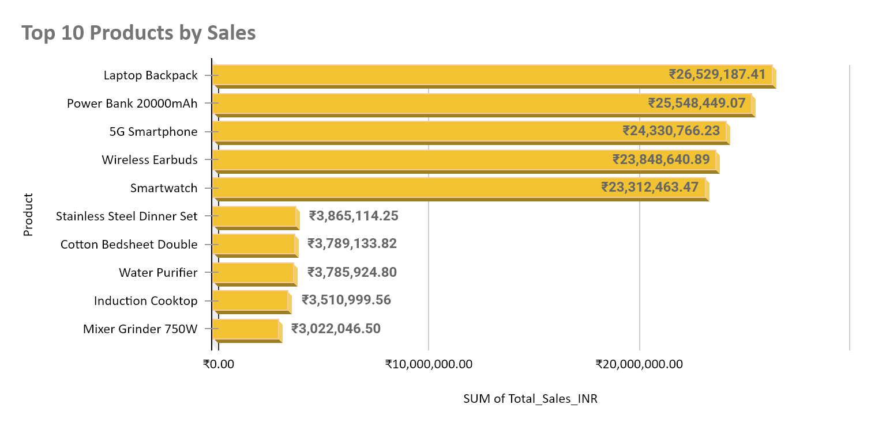
Category & Product Performance

Slide 8
Order Status & Revenue Loss
Delivered
8147
Cancelled
500
Revenue loss = returned revenue + cancelled revenue
₹15,648,742.64
Shipped
868
Return Rate
4.85%
Returned
485
Cancelling rate
5.00%

Slide 9
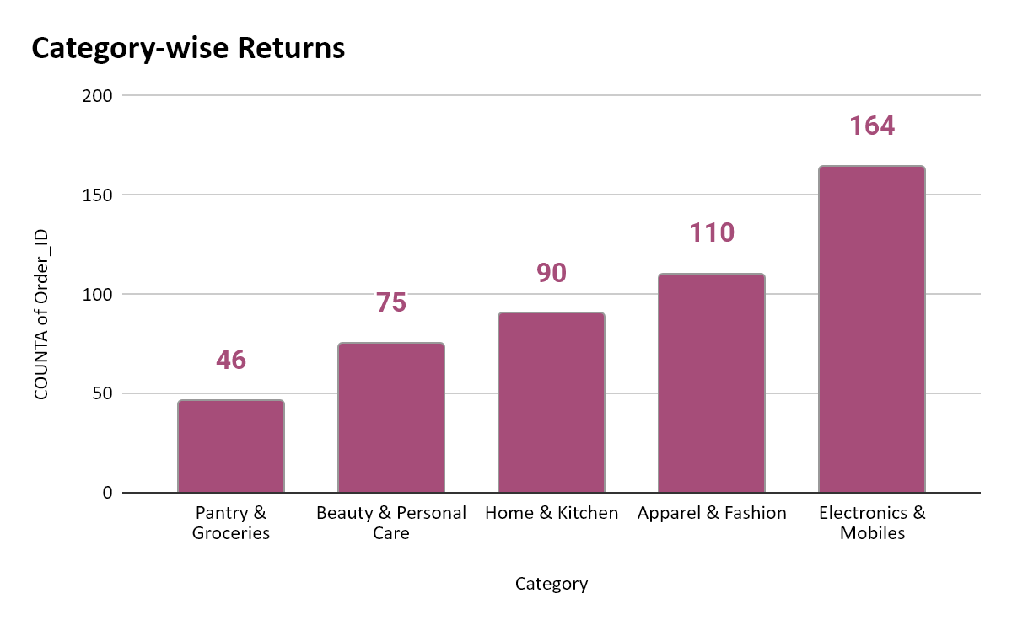
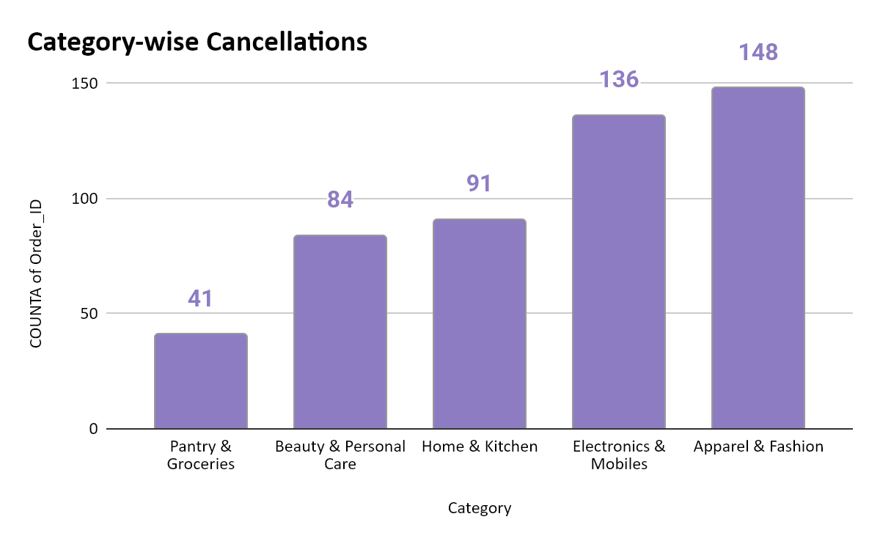
Order Status & Revenue Loss

Slide 10
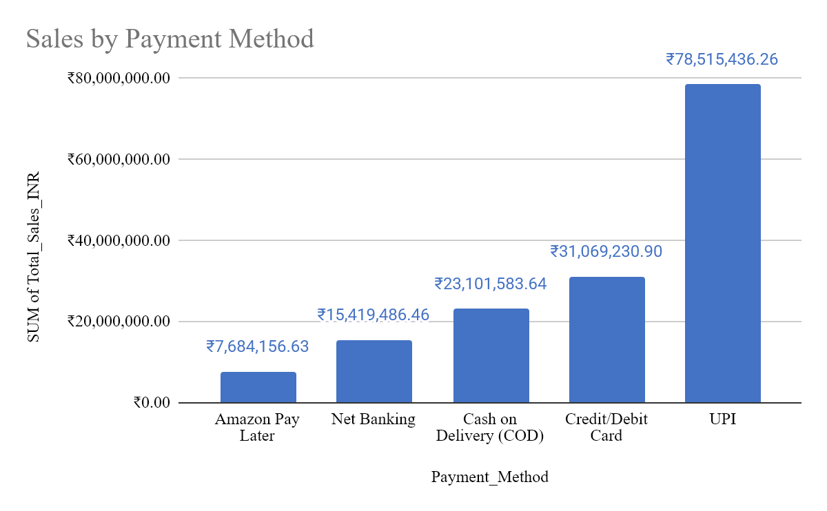
Payment, Fulfillment & Geographic Performance

Slide 11
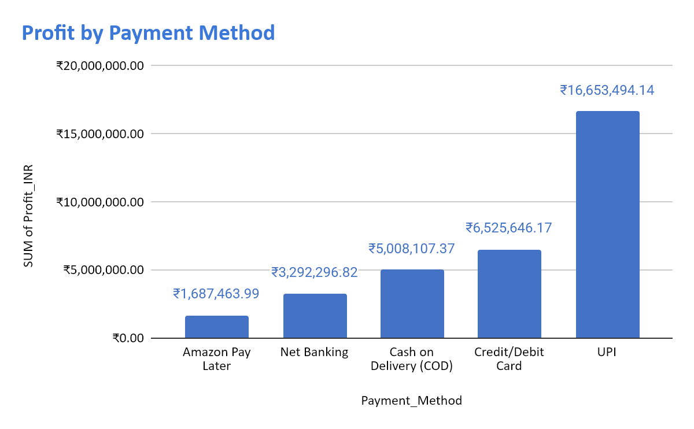
Payment, Fulfillment & Geographic Performance

Slide 12
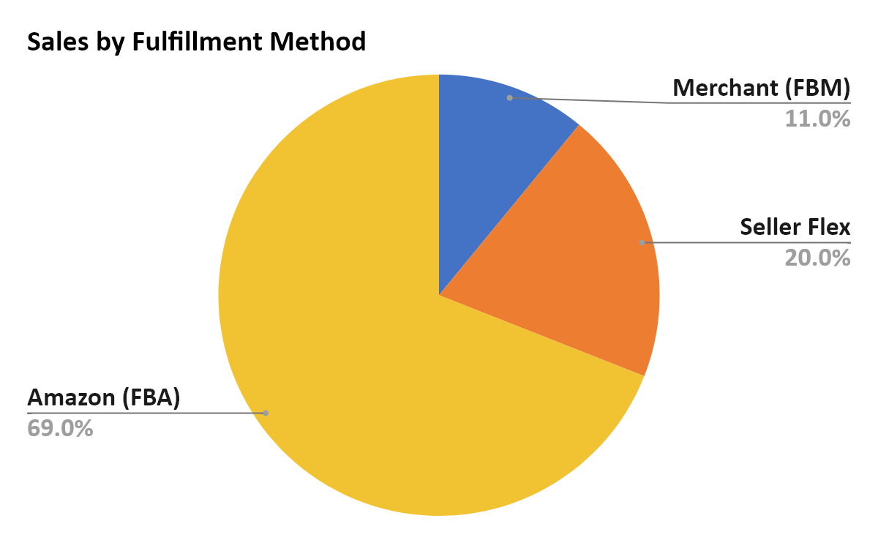
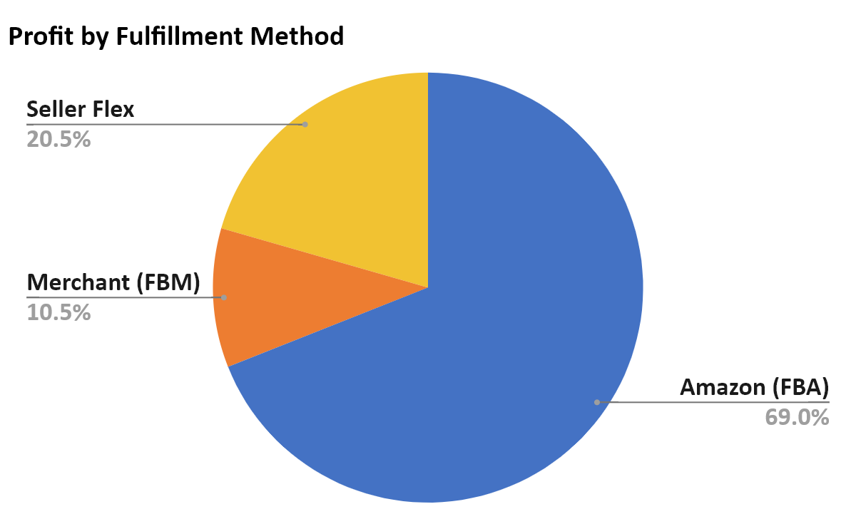
Payment, Fulfillment & Geographic Performance

Slide 13
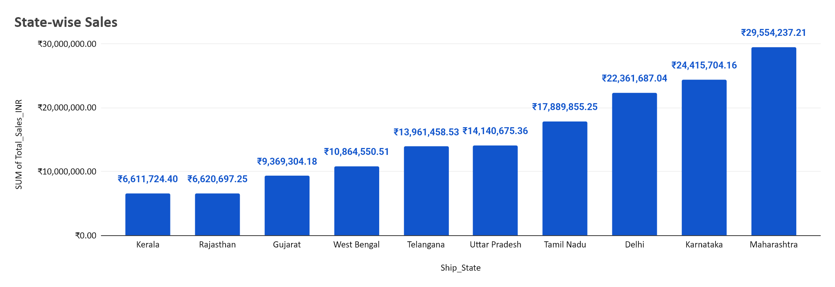
Payment, Fulfillment & Geographic Performance

Slide 14
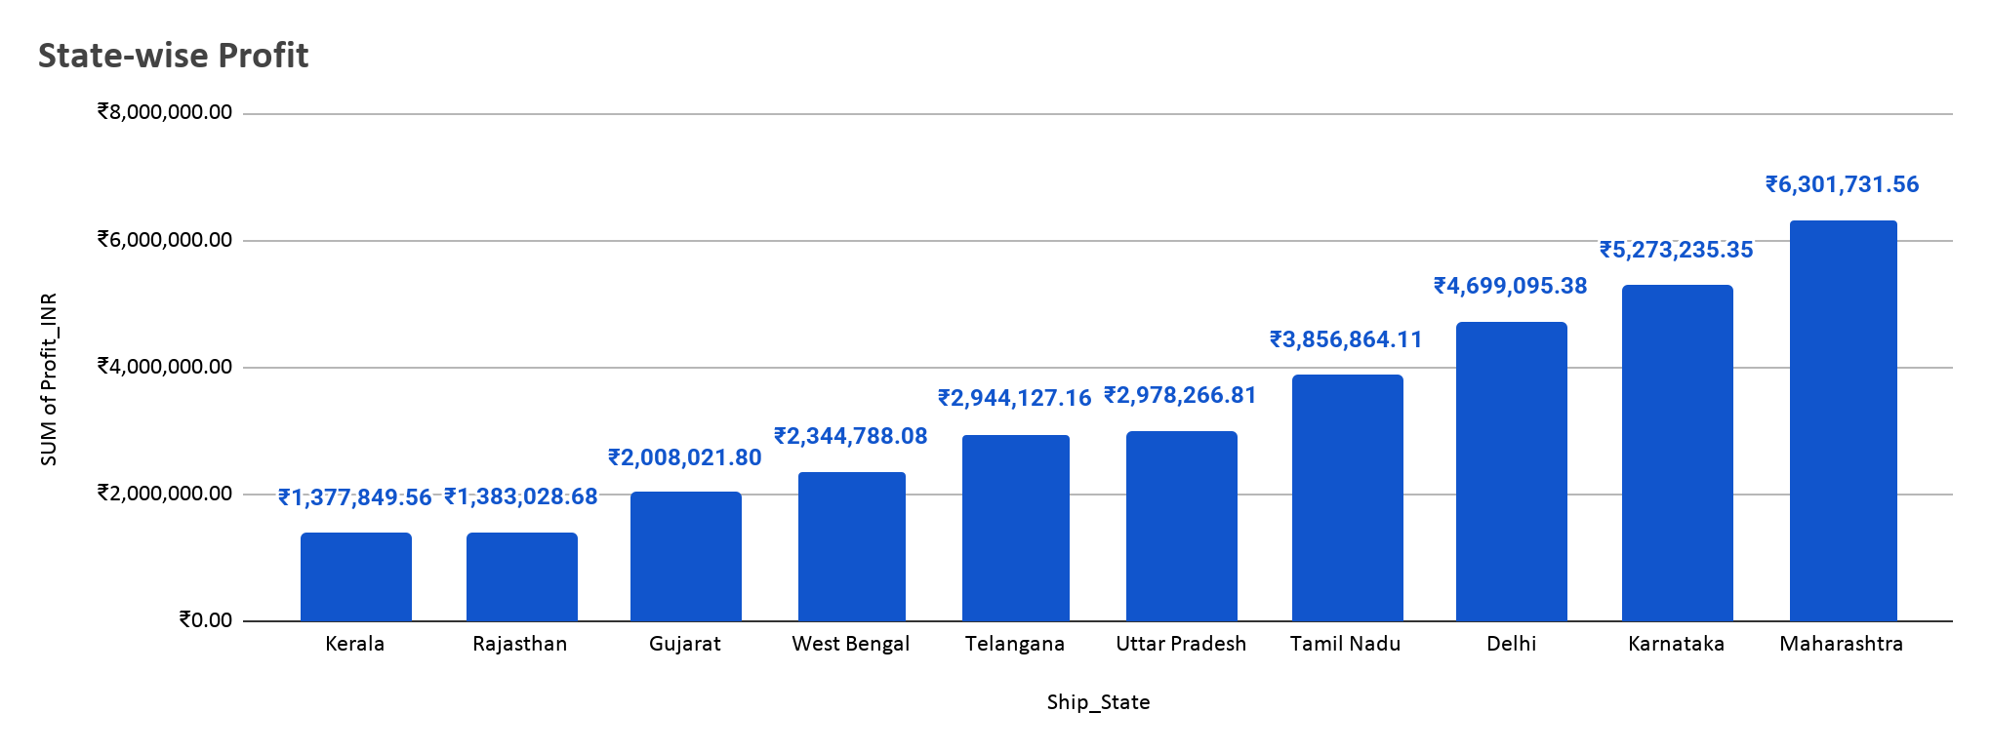
Payment, Fulfillment & Geographic Performance

Slide 15
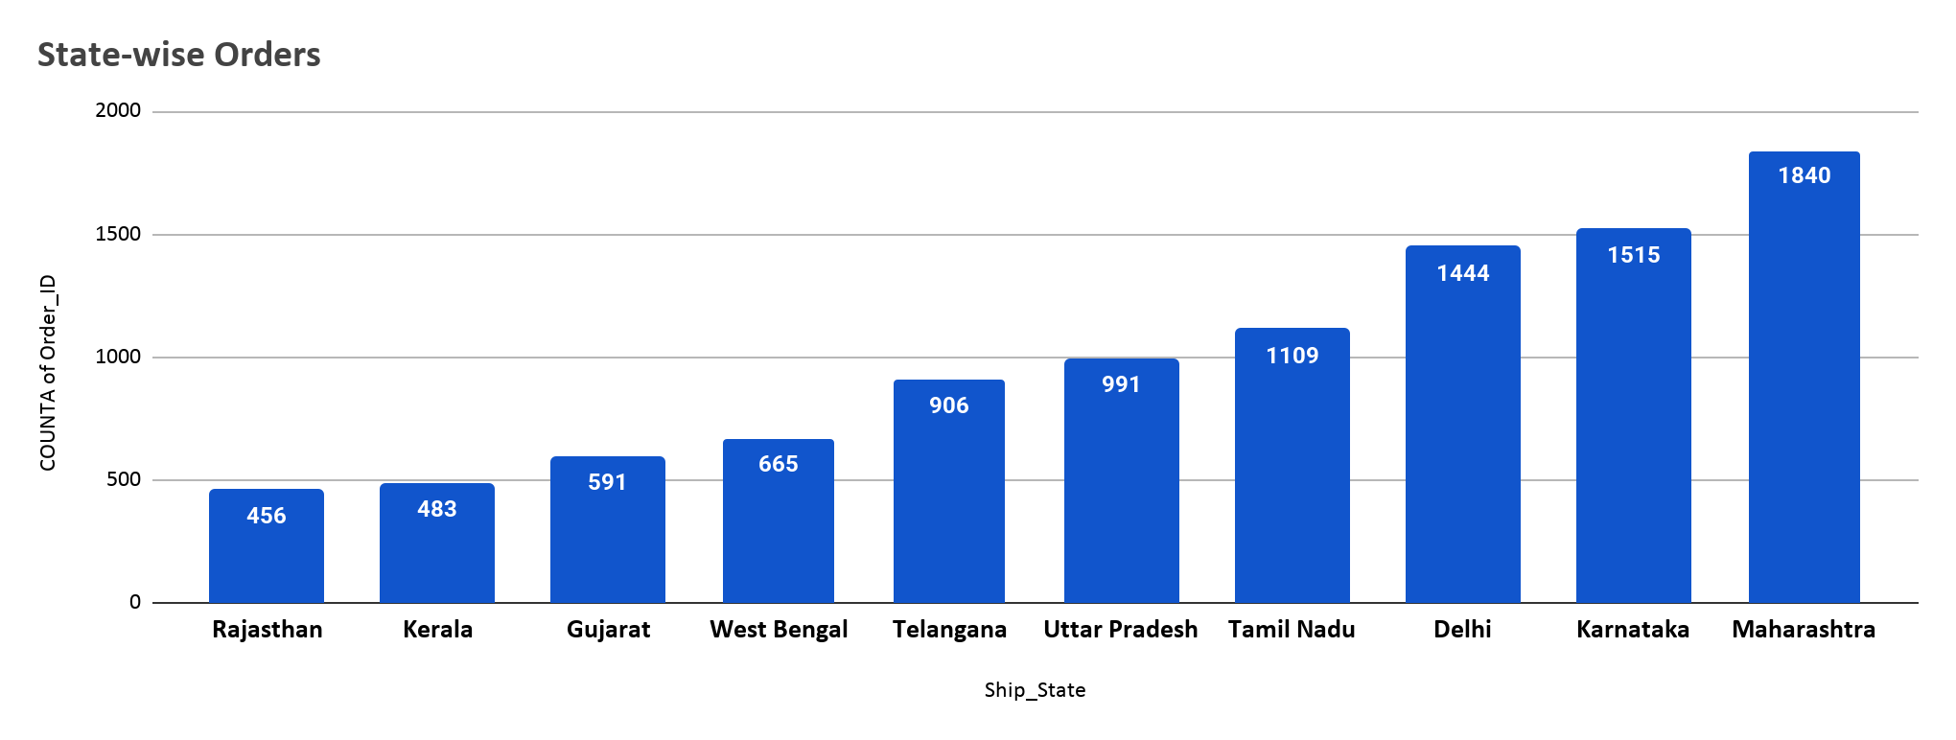
Payment, Fulfillment & Geographic Performance

